Slide 1


IBM Applied Data Science Capstone Project
Best Place to eat authentic mexican food in mexico city

Slide 2





Agenda
Introduction and business problem
data
CONclusion
methodology
analysis
Results

Slide 3
Introduction and business problem
Mexico is famous for its gastronomy
New visitors usually want to know what’s the best place to eat authentic Mexican food.
Mexico city, being a diverse city of more tan 20 million habitants, has too many option. It can be overwhelming.
USING DATA AND DATA SCIENCE TOOLS, WE WILL DEFINE WHAT ARE THE BEST PLACES TO EAT, ANDHOPEFULLY FIND SOMETHING INTERESTING ALONG THE WAY

Slide 4
DATA
Most of the data will come form the FourSquare API, where we will be paying special attention to:
Venue name and id
Venue Category (Only Mexican restaurants, museums, monuments, historical places of interest and hotels will be considered).
Venue rating
Venue location
Venue coordinates

Slide 5
Methodology
Data processing to turn the FourSquare results into readable and processable data.
K-Means usage to get clusters of restaurants according to their quality.
Plotting of clusters (red: top quality, blue medium quality, green bottom quality, yellow: city center)

Slide 6
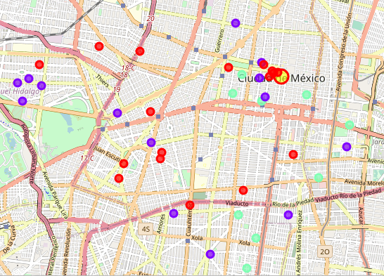
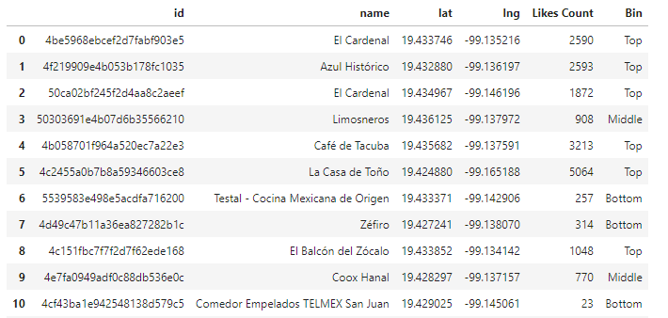
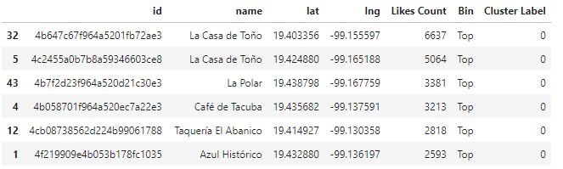
Analysis

Slide 7
Results and conclusions
There are quality options all over the city
There’s a larger than normal concentration near city center.
The city center, having many historical sites, and many quality authentic Mexican restaurants, seems to be a great place to book a room for tourists.
Even if not staying near the city center, there are still great options to eat almost everywhere.
“Casa de Toño”, has 3 restaurants in the top 50 of Mexico City. This is quite interesting, considering a relative new franchise that started very small a few years ago. Further study on this phenomenon could be a great new project.

Slide 8

Thank you

